Slide 1
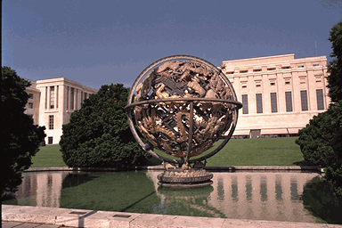

INTERNATIONAL
ORGANIZATIONS
EVOLVING ROLES
Dr. Walter Dorn
Canadian Forces College
31 October 2012
Notes:
“Things are the way they are because they got to be that way.” Not merely a statement of the obvious but a pearl of wisdom.

Slide 2
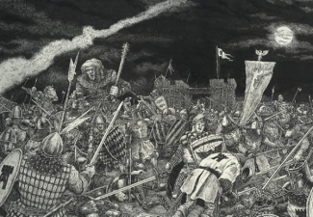
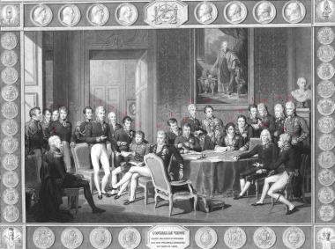
Starting from nothing ...
Medieval Age
Treaty of Westphalia (1648)
Age of Empires
Concert of Europe
    Congress of Vienna (1815)
    Not centralized or permanent
alchemipedia.blogspot.com
Wikipedia

Slide 3
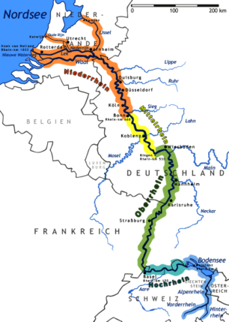
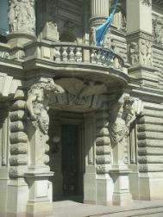

Rhine Commission
“Central Commission for Navigation on the Rhine”
  Congress of Vienna
  Hq at Strasbourg
  Oldest extant IO

Slide 4


International Telecommunications Union (ITU)
  1865: “Telegraph” Union
  Geneva
Universal Postal Union (UPU)
  1874: Bern

Slide 5
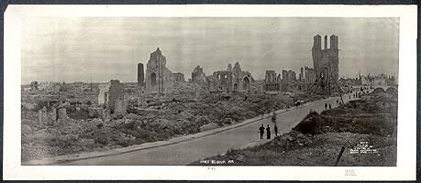
World War I
Clash of empires; “fruits of civilization?”
Origin of international organization (IO) for peace
  After destruction, new hopes and dreams
  Sacrifice, progressive spirit, imperative of prevention

Slide 6
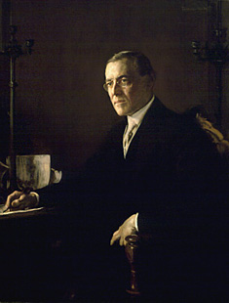
The Seed Idea
“A general association of nations must be formed under specific covenants for the purpose of affording mutual guarantees of political independence and territorial integrity to great and small states alike.”
  President Woodrow Wilson,
  Fourteenth Point,
  8 January 1918

Slide 7
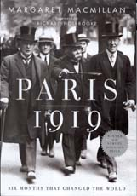
1919
First IO for peace:
The League of Nations
  Basic structures and principles of IO
Recurring tension between idealism and realpolitik
  Great treaty debate 1919-20

Slide 8
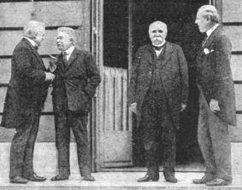
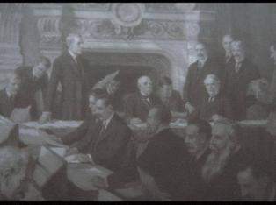
League of Nations
“Big Four”
“A living thing is born”
  – W. Wilson, 14 February 1919
League Covenant
  EIF: January 1920

Slide 9
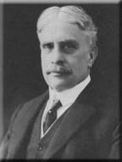
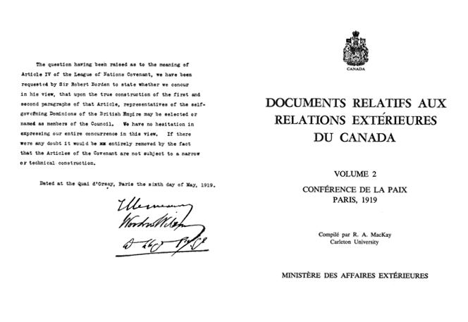
Canadian Representation
“The self-governing Dominions of the British Empire
may be selected or named as members of the [League] Council”

Slide 10
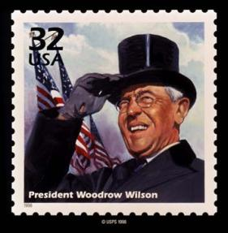
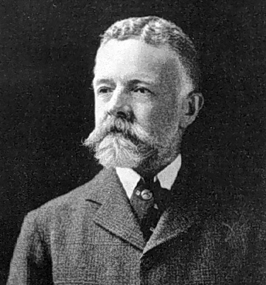
Internationalism (Wilson) vs Nationalism (Lodge)
There must be now, not a balance of power, not one powerful group of nations set off against another, but a single overwhelming, powerful group of nations who shall be the trustee of the peace of the world.
  The United States is the world's best hope, but if you fetter her in the interest through quarrels of other nations, if you tangle her in the intrigues of Europe, you will destroy her powerful good, and endanger her very existence.

Slide 11
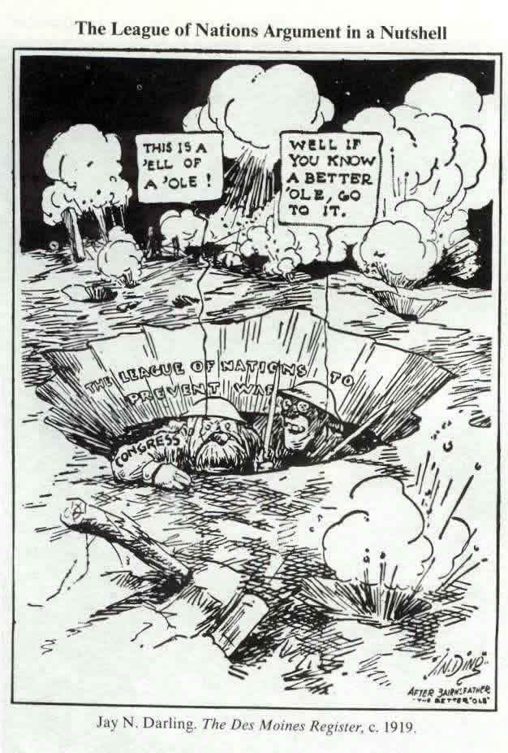
Notes:
Mimics famous WW I cartoon character “Old Bill” by Bruce Bairnsfather

Slide 12
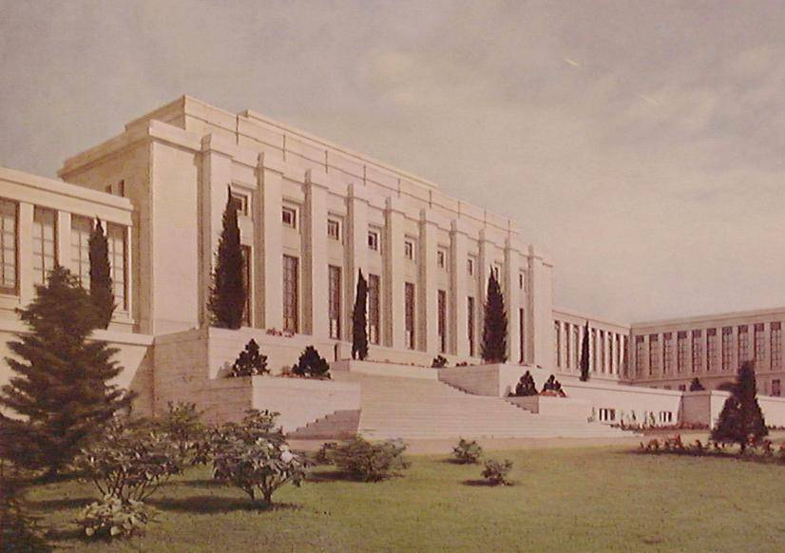
League of Nations
First international organization for peace
Palais des nations, Geneva

Slide 13
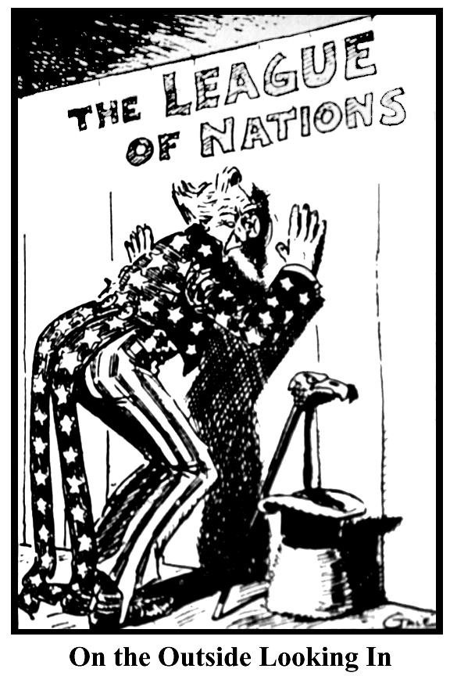
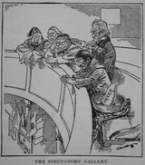
Outside the League

Slide 14
Successes of the League (1920s)
The Aaland Islands (Finland, Sweden), 1921
Upper Silesia (Germany-Poland), 1921
Memel (Lithuania), 1923
Turkey (humanitarian), 1923
Greco-Bulgarian frontier, 1925
The Saar, 1920-35
See: http://www.historylearningsite.co.uk/leagueofnations.htm

Slide 15
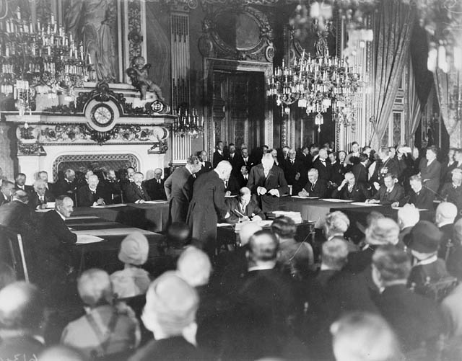
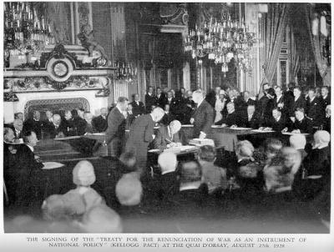
Outside the League: Misplaced Idealism
Kellogg-Briand Pact
1928
Pledge to “renounce [war] as an instrument of national policy in their relations with one another”
Frank Kellogg: US Secretary of State
Aristide Briand: French FM
64 signatories, incl. Germany, Canada
Words without implementing machinery
National Archives of Canada

Slide 16
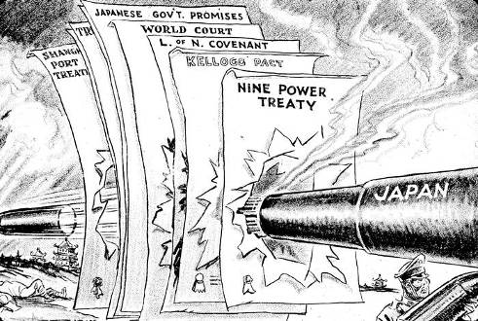

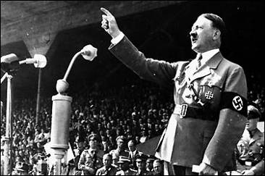
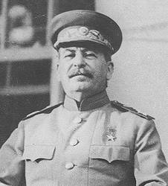
Major Failures of the League (1930s)
Japan invades Manchuria, 1931
Mussolini invades Abyssinia, 1935
Germany marches into Rhineland, 1936
Soviet Union invades Finland, 1939

Slide 17
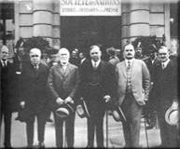
Canada in the League
“in this association of Mutual Insurance against fire, the risks assumed by the different States are not equal. We live in a fire-proof house, far from inflammable materials.”
  Senator Raoul Dandurand,
  leader of Mackenzie King’s Liberal
  government in the Senate,
  to the League Assembly 1924
Attempts to emasculate Article X
Oil sanctions against Mussolini
DFAIT
Canadian delegation, 1928
L to R: O.D. Skelton, P. Roy, Sen. R. Dandurand, W.L. Mackenzie King, C. Dunning and W. Riddell
Notes:
Canada at the League of Nations, 1928. Left to right: O.D. Skelton, Philippe Roy, Senator Raoul Dandurand, W.L. Mackenzie King, Charles Dunning and Walter Riddell.

Slide 18
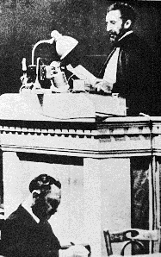
Haile Salassie in Geneva
“Should it happen that a strong Government finds it may with impunity destroy a weak people, then the hour strikes for that weak people to appeal to the League of Nations to give its judgment in all freedom. God and history will remember your judgment …
“It is us today. It will be you tomorrow.”
  30 June 1936
Source: http://www.mtholyoke.edu/acad/intrel/selassie.htm

Slide 19
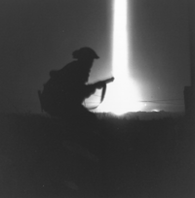
World War II
Germany invades Poland: September 1, 1939
  Britain declares war two days later
  Canada: Sept 10
League of Nations impotent
  Some functions transferred to McGill & Princeton universities
US “rudely awakened” at Pearl Harbour
VE day: 8 May 1945
End WWII: 2 Sept

Slide 20
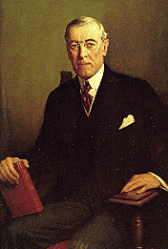
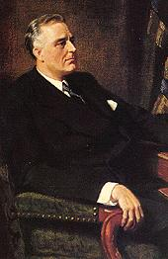
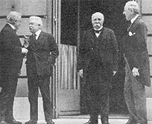
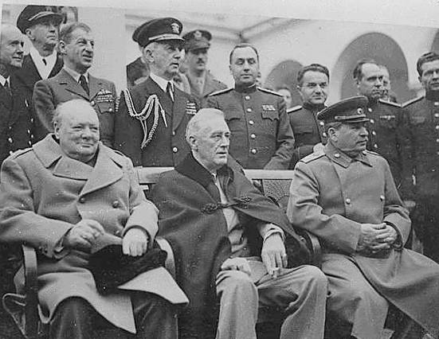
Two Presidents in War/Peace
Notes:
The Big Four vs The Big Three

Slide 21
1945
To refine League system
or
To create whole new system?

Slide 22
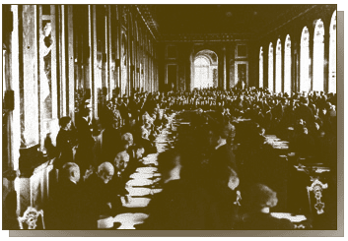
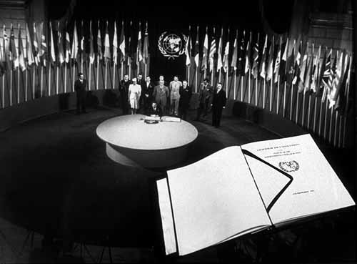
Constituent Documents
League Covenant
UN Charter

Slide 23
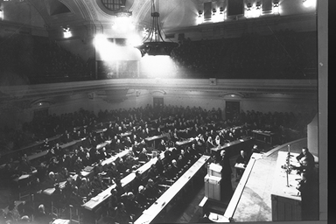
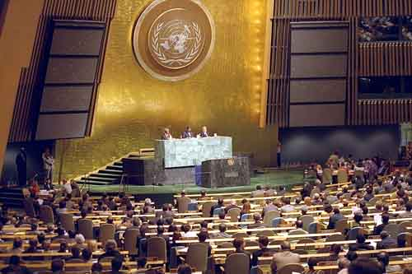
Membership
League of Nations
Assembly
Over 60 members
United Nations
General Assembly
193 members (universal)

Slide 24
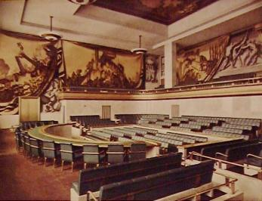
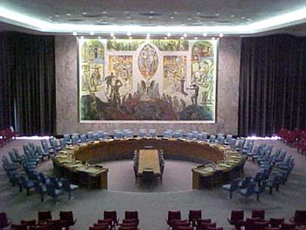
Council: Selected States
Council
Four permanent:
France, Italy, Japan & UK
Security Council
Five permanent:
China, France, UK, USA, USSR/Russia

Slide 25
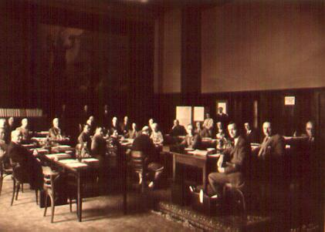
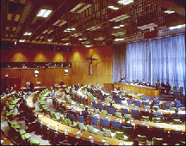
Mandates / Trusteeship
UN
UN
Mandates Commission
Trusteeship Council

Slide 26
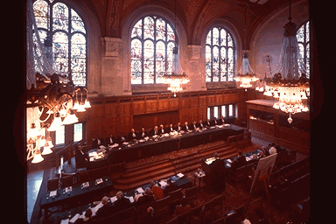
Courts of Justice
* Permanent Court of International Justice
became
International Court of Justice (ICJ or “World Court”)
same Statute, same location (The Hague)

Slide 27
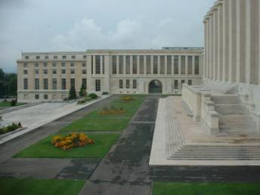
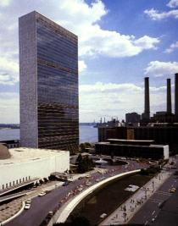
Secretariat
Geneva
Palais des Nations
New York
“Glass Palace”

Slide 28
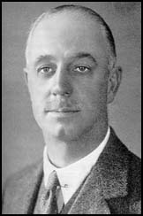
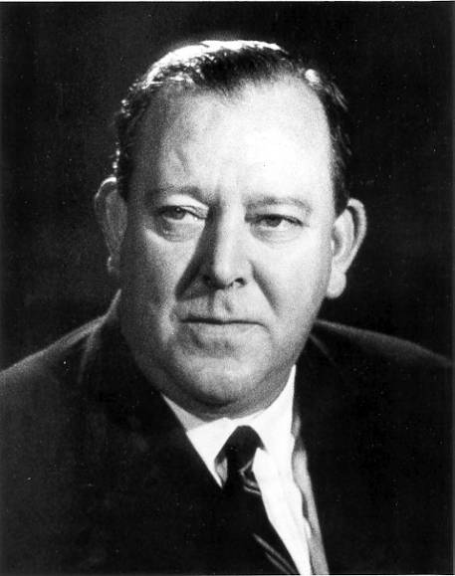
Secretaries-General
Trygve Lie
Expanded SG’s independent role
Sir Eric Drummond
Nonpartisan “International Civil Service”

Slide 29
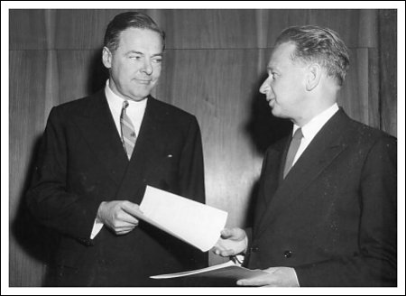
US Participation
1919/1920
US Senate Foreign Relations Committee:
Over 40 amendments
14 Lodge reservations
No ratification
1945
US Senate adopts Charter
Without reservations
Henry Cabot Ledge Jr. becomes ambassador to the UN

Slide 30
League-UN Constitutions:
Main differences
UN to have armed forces at its disposal
More power to Security Council
Removal of qualified unanimity rule
  P5 veto
Greater emphasis on human rights, economical and social issues, decolonization
Greater commitment to UN in West
  US membership, e.g., Canadian support
Greater “political will” BUT Cold War limitations

Slide 31
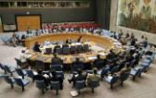
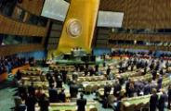
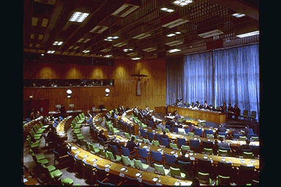
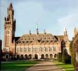

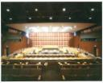
UN’s Six Principal Organs
SECURITY
COUNCIL
(5+10)
GENERAL
ASSEMBLY
(193)
TRUSTEESHIP
COUNCIL
INTERNATIONAL
COURT OF JUSTICE
(15)
ECONOMIC AND SOCIAL COUNCIL
(54)
SECRETARIAT

Slide 32
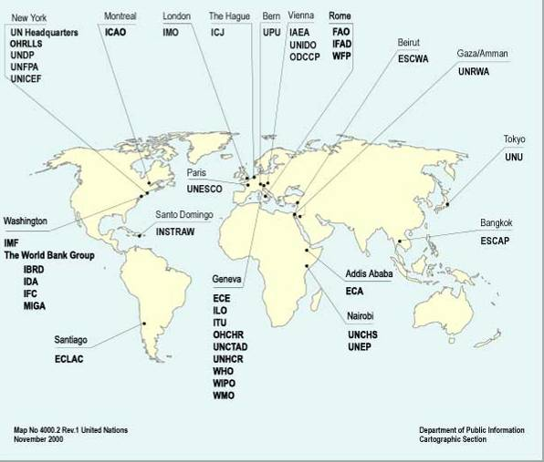
Growing UN Family of Agencies

Slide 33



Selected Events
Universal Declaration of Human Rights (1948 )
Seating of Communist China (1971)

Slide 34

“Police Action” in Korea 1950:
Vindication of Collective Security

Slide 35



US Leadership
UN

Slide 36



Cuban Missile Crisis
October 1962
Stephenson-Zorin,
Security Council debate
– October 25
Notes:
http://www.youtube.com/watch?v=MSV9_J8Csts
http://www.youtube.com/watch?v=MSV9_J8Csts&playnext=1&list=PL322715D051422FE3&feature=results_main

Slide 37


Slide 38


Canadian Internationalism
“The UN’s vocation is Canada’s vocation.”
  Louis St. Laurent,
  Secretary State for External Affairs, 1946
Contributions to
UN Command
in Korea
  27,000 troops
  Over 500 deaths
DND
Notes:
"Living next to you is in some ways like sleeping with an elephant: No matter how friendly and even-tempered the beast, one is affected by every twitch and grunt."
March 25, 1969
Addressing the Press Club in Washington, D.C.
"As Canadian as possible."
-- Reportedly the winning entry in a contest to come up with the best Canadian equivalent to the phrase "As American as apple pie." Supposedly this was reported in MacLean's - if anyone can provide the citation, I'd sure appreciate it! [ADDED: 31 MAY 1998]

Slide 39



“Golden Age” of Canadian Diplomacy (1945-1957)
General Andrew McNaughton
  Canada's first permanent delegate to UN in New York, 1948; Security Council President, 1949
Brig. Harry Angle
  Chief Military Observer, UNIMOG, July 1950
  First Canadian to die in a peacekeeping mission
Lt. Gen. Tommy Burns
  Chief of Staff, UNTSO, 1955-56
  First Commander, UN Emergency Force, 1956-

Slide 40
Nobel Peace Prize 1957
“given primarily for his role in trying to end the Suez conflict and to solve the Middle East question through the United Nations.”
– Norwegian Nobel Committee
  Lester B. Pearson,
  Oslo, Dec. 11, 1957
Notes:
Address: http://www.nobel.se/peace/articles/lundestad-review/
Accessed 4 July 2002

Slide 41


Early Evolution of
UN Peacekeeping
Observers
Interposed Forces

Slide 42

Peacekeeping Expansion
18 established during Cold War, 50 since
New mandates, new personnel
  Civilian police, civilians
DPKO (1992-)
  Situation Centre (1993-)
    24 Hour Duty room
    Information and Research Unit ('94-'99)
Sharing peacekeeping with NATO and regional organizations

Slide 44
Multidimensional Nature of
Modern Peacekeeping
Political
Military
Humanitarian
Police
Economic
Social
Reconstruction
Judicial

Slide 45

Uniformed UN Peacekeepers (1992–)

Slide 46
Peacebuilding
Elections monitoring
  first in UN member state in 1989; dozens since
Security sector reform
  Bosnia, Guatemala, etc.
  Monitoring military, police, customs officials, border guards, corrections, intelligence
Transitional administration / territorial governance
  East Timor, Kosovo
Convergence of development & security
Peacebuilding Commission & UN offices

Slide 47


Slide 48
Human Rights Monitoring
  High Commissioner, OHCHR (est. 1993)
  Special Rapporteurs/Reps:
    6 in '80s;
    17 in '90s;
    36 in '00s
  “Field presence” in 25 states (on-site staff)
  Truth Commissions created for first time in 1990s
    El Salvador, Guatemala, Sierra Leone, East Timor, etc.
    Guatemala Historical Clarification Commission– probed historical record over 30 years (Guatemala) in Central America
    Ongoing monitoring
Notes:
Total number of monitoring bodies created in 1990s: _____

Slide 49




International Criminal
Tribunals & Court
ICTY (1993-) ICTR (1994-)
ICC (2002-)

Slide 50


Slide 51
Peace Enforcement: Types
Sanctions
  Monitoring compliance; assessing impact
  Military role
Enforcement (Military Action)
  Gulf War (1991), Kosovo Bombing (1999, without SC resolution), Libya (2011)
Coercive Disarmament
  UNSCOM/UNMOVIC: Intelligence-sharing issues
Notes:
Arab States (1948), North Korea (1950), Congo(1961), Portuguese Government (1963), South Africa (1963), Southern Rhodesia (1965), Iraq(1990), former Yugoslavia (1991), Somalia (1992), Libya (1992), Liberia (1992), Cambodia (1992), Haiti (1993), Armenia-Azerbaijan (1993), Angola/UNITA (1993), Georgia(1993), Rwanda (1994), Sudan (1996), Sierra Leone (1997), etc.

Slide 52
Sanctions
Sanctions committees
  Only two committees to 1990: South Africa (1963-94), S. Rhodesia (1965-79)
  Ten in 1990s: Iraq (1990-), former Yugoslavia (1992-98), Somalia (1992-94), Libya (1992-94), Liberia (1992-97), Haiti 1993-94), Angola/UNITA (1993-), Rwanda (1994-98), Sierra Leone (1997-), Afghanistan (1999-)
  Many in 2000-2010: Eritrea-Ethiopia (2000-01), Liberia (2001); Iran (2006-); Libya (2011)
National submissions
  Over 40,000 communications in one year
Sanctions Enforcement Support Teams
  Neighboring countries

Slide 53
Tensions and Dynamics
Sovereignty versus common interest
  Intervention
  « Corridor diplomacy »
Security Council composition
  Realist vs democratic
  Achievement
  Reform process
Limitations
  Wide range of interests, cultures, skills
  Legitimacy
Global problems require global solutions!

Slide 54
25 Year Predictions
GA:
  Creation of Parliamentary Assembly
SC:
  New seats (e.g., Rotating + Brazil + India + Japan);
  British, French seats merge into EU seat
  Limits on veto and enforcement (including ICJ review of SC decisions)
Secretariat:
  Revamped election procedure for SG;
  global open skies agreement with UN agency
  greatly improved early warning systems

Slide 55
Legal:
  ICJ compulsory jurisdiction nearly universal
  New treaties on jurisdiction over individuals
  ICC Expansion (2017 – Crime of aggression)
  Verification of the ban on secret treaties (Art. 102)
Financial:
  International taxation (e.g., armaments/financial transactions)
Military:
  Standing peace-keeping forces (nucleus under direct UN employment)

Slide 56

Re-Organization International
http://walterdorn.org/pub/11

Slide 57
“Truth is stranger than fiction.”

Slide 58

UN

Slide 59

“What we seek is the rule of law based on the consent of the governed and sustained by the generalized opinion of mankind.”
      President Woodrow Wilson
National PortraitGallery

Slide 60
THE END
… OF THE BEGINNING

Slide 61


Slide 62


Slide 63


